Slide 1
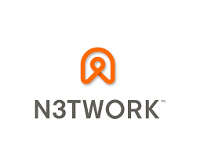
TRENDING APPS DETECTION
Kate Mizgireva • Katie Balcewicz • Zach Kidd
Data Science Data Science Data Science
MUSC Data Science Intern Office of Admissions Student Student
Data model Builder

Slide 2
Web scrape data from Apple and Android App Stores
Detect the outlier trending apps
Message N3TWORK about top trends
PROJECT DESCRIPTION

Slide 3










TECHNOLOGIES USED
repository, scrum management communication, updates, tracking database
storage, hosting virtual machine web scraping
daily scripts main scripts predictive modeling data collections

Slide 4
PROJECT PIPELINE
Web-scrape using node.js
Upload Data into Google Cloud
Load into MongoDB
Build Pandas DataFrames
Predict trending apps using outlier detection

Slide 5
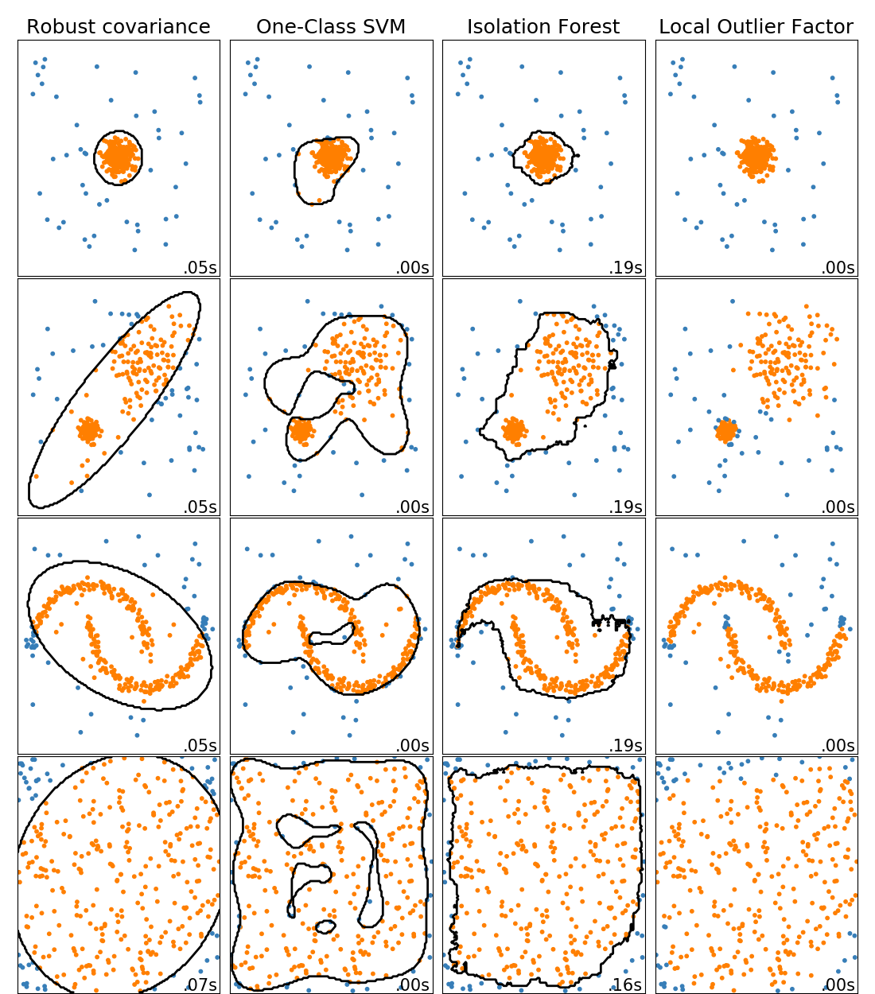
OUTLIER DETECTION ALGORITHMS

Slide 6
PROJECT PIPELINE
Sprint 1: Zach (1/31-2/26) web-scrap the data, put it into database, design the database architecture
Sprint 2: Kate (2/27-4/1) Create dataframes, model the data, build predictive models
Sprint 3: Katie (4/2-5/2) Wrap up, combine python scripts into one, build e-mail script

Slide 7
Challenges and triumphs
Incorrectly formatted Json files
Bug in Google Play scraper
Learning many new technologies

Slide 8
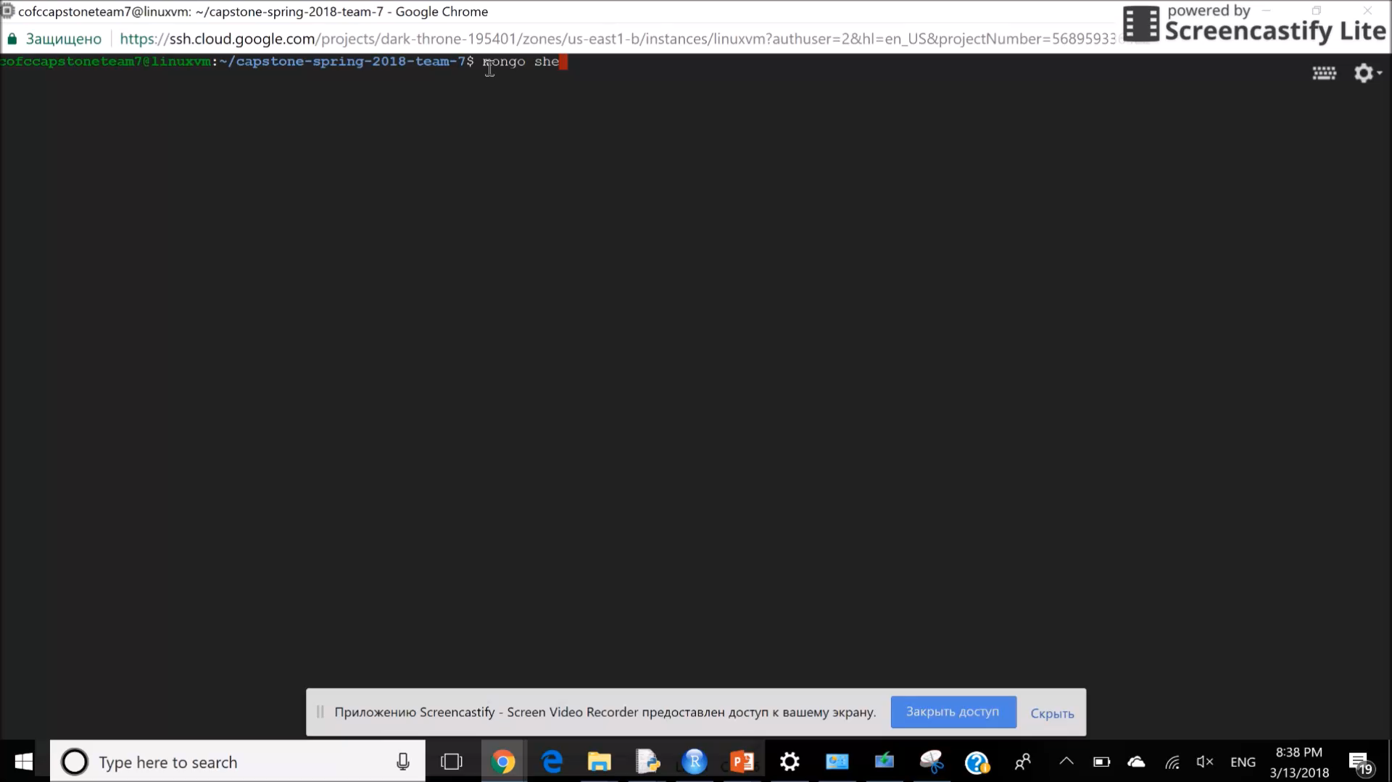

Slide 9
Thank you for your Attention

